Slide 1
Industrial Engineering & Management lesson(7)

Slide 2
Perceived goals and objectives of the company*
A- Market data Projected share of the market Market prices
Market growth
Markets the company serves
Competition, both domestic and global
Project and/or product life
B- Capital requirements
Fixed capital investment Working capital
Other capital requirements

Slide 3
C- Operating expenses
Manufacturing expenses Sales expenses
General overhead expenses
D- Profitability
Profit after taxesاCash Flow
Payout period
Rate of return
Returns on equity and assets
Economic value added
E- . Projected risk
Effect of changes in revenue
Effect of changes in direct and indirect expenses
Effect of cost of capital
Effect of potential changes in market competition

Slide 4
SOURCES OF FUNDS
The funding available for corporate ventures may be obtained from internal or external sources.
A- Internal Sources
The capital from internal sources is from retained earnings or from an allowance known as reserves. Internal financing is “owned” capital, and it is argued that it could be loaned or invested in other ventures to receive a given return. In determining the cost of owned capital, interest to be paid on this capital is equal to the present return on all the company’s capital
B- External Sources
There are three sources of external financing: debt, preferred stock, and common stock. These sources vary widely with respect to the cost and the risk the company assumes تفترض with each of these financing sources. The cheapest form of capital is the least risky. A general rule is the riskier the project, the safer should be the type of financing the capital used. A new venture with modest capital requirements could be funded by common stock. In contrast, a well-established business area may be financed by debt.

Slide 5
Estimation of Capital Requirements
Total capital investment includes funds required to purchase land, design ,purchase, and install equipment and buildings, as well as to brine
A list of these items includes:
1. Land
2. Fixed capital investment
3. Offsite capital
4. Allocated capital
5. Working capital
6. Start-up expenses
7. Other capital items (Interest on borrowed funds , Catalyst and chemicals , Patents, licenses, and royalties )g the facility into operation.

Slide 6
2- FIXED CAPITAL INVESTMENT
The fixed capital investment for a plant includes the manufacturing equipment, piping, ductwork, automatic control equipment, structures, insulation, painting, site preparation, and environmental control equipment, as well as engineering and contractor’s costs.
2.1 Capital Cost Estimates
When a firm considers a project to manufacture a product, a capital cost estimate is prepared. An in-house engineering staff may develop the estimate, if the staff is large enough, or the estimate may be outsourced to an engineering or consulting company..

Slide 7
2.1.1 Classification of Estimates
There are two broad classes of cost estimates: grass-roots and battery-limits estimates. The former, also called a green-field estimate, is a descriptive term. It means the entire facility is estimated starting with site preparation and includes building and structures, processing equipment, utilities, service facilities, storage facilities, railroad yards, and docks. A battery-limits estimate is one in which there is an imaginary boundary drawn around the facility to be estimated. It is assumed that all raw materials, utilities, services, etc. are available at the boundary in the proper quantity and with the desired quality to manufacture the product in question. Only costs within this boundary are estimated—hence the name battery-limits estimate.

Slide 8
2.1.2 Quality of an Estimate
Capital cost estimation is more an art than a science. An estimator must use a great deal of judgment in the preparation of an estimate. As the estimator gains experience, the accuracy of the estimate improves.
2.1.3 Equipment Cost Data
The foundation of a fixed capital investment estimate is the equipment cost data. From these data, through the application of factors or percentages based upon experience, a fixed capital investment estimate may be prepared. It is essential to have reliable equipment cost data but the engineer preparing the estimate must exercise good judgment in the selection and application of the data. There are many sources of data listed in the literature, but some are old and the latest data published was in 1990. There has been no significant cost data published in the open literature since that date. It is essential for the estimator to know:

Slide 9
. Source of the data
. Basis for the cost data
. Date of the cost data
. Potential errors in the cost data
. Range over which the cost data apply
2.1.3. Data Presentation. Cost data are stated as purchased, delivered, or installed costs. Purchased cost is the price of the equipment FOB (free on board) at the manufacturer’s plant. Delivered cost is the price of the equipment plus delivery charges to the purchaser’s plant FOB.
Some cost data are reported as installed cost. This means the equipment
item, for example, a centrifugal pump has been purchased, delivered, uncrated, and placed on a foundation in an operating department but does not include piping, electrical, insulation costs. Perhaps a more accurate term would be set-in place cost

Slide 11
Example 4.1:Problem Statement: Recently a cast iron leaf pressure filter with 100 ft2 was purchased for clarifying an inorganic liquid stream for $15,000. In a similar application, the company will need a 450 ft2 cast iron leaf pressure filter. The size exponent for this type filter is 0.6 (see Appendix
D). Estimate the purchased price of the 450 ft2 unit.

Slide 12
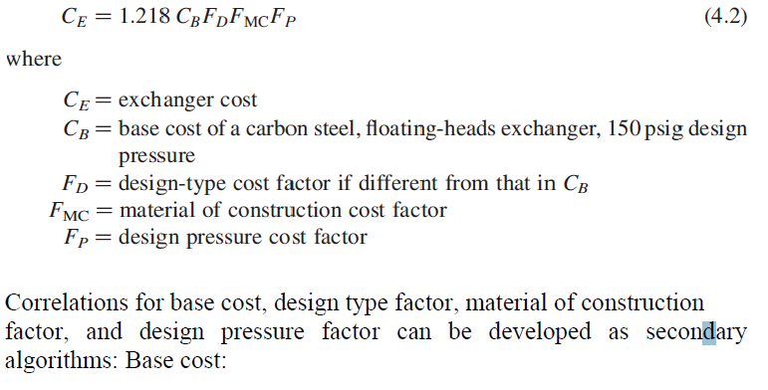
Algorithm Format. A more convenient way to display cost-capacity data is by an algorithm.

